Slide 1
Online User Behaviour Analysis
G.Manasa(171FA04264) Sk.Afrid(171FA04236) T.Charitha(171FA04243)

Slide 2

Online User Behaviour Analysis

Slide 3
Contents:
Introduction
Motivation
Objectives
Related Work
Proposed system
Architecture diagram
Experimental Results
Discussions
Conclusion
References

Slide 4
Introduction
As online shopping is increasing, large amount of data on people’s online activities have become available on web.
Use of such data can benefit a lot of applications.
They will analyse the transactions keenly and identify the set of items that were brought more frequently.
They will also identify the products which are brought in addition to other products more frequently.
Because of such analysis they will identify which products have more demand.
Thus they can recommend those customers to the users who are having the similar purchase pattern.

Slide 5
Motivation
Consumer Behavior is a complex and challenging field to analyse by the marketer as preference vary over a period of time.
Here the traditional method of purchase is replaced with online model that facilitating the consumer anytime to purchase the goods by providing all the benefits under a single roof
Our project “Online user behavior analysis” will mainly focus upon the user purchasing or shopping behaviour via internet.
Here we used market basket analysis to find out the association rules between transcations

Slide 6
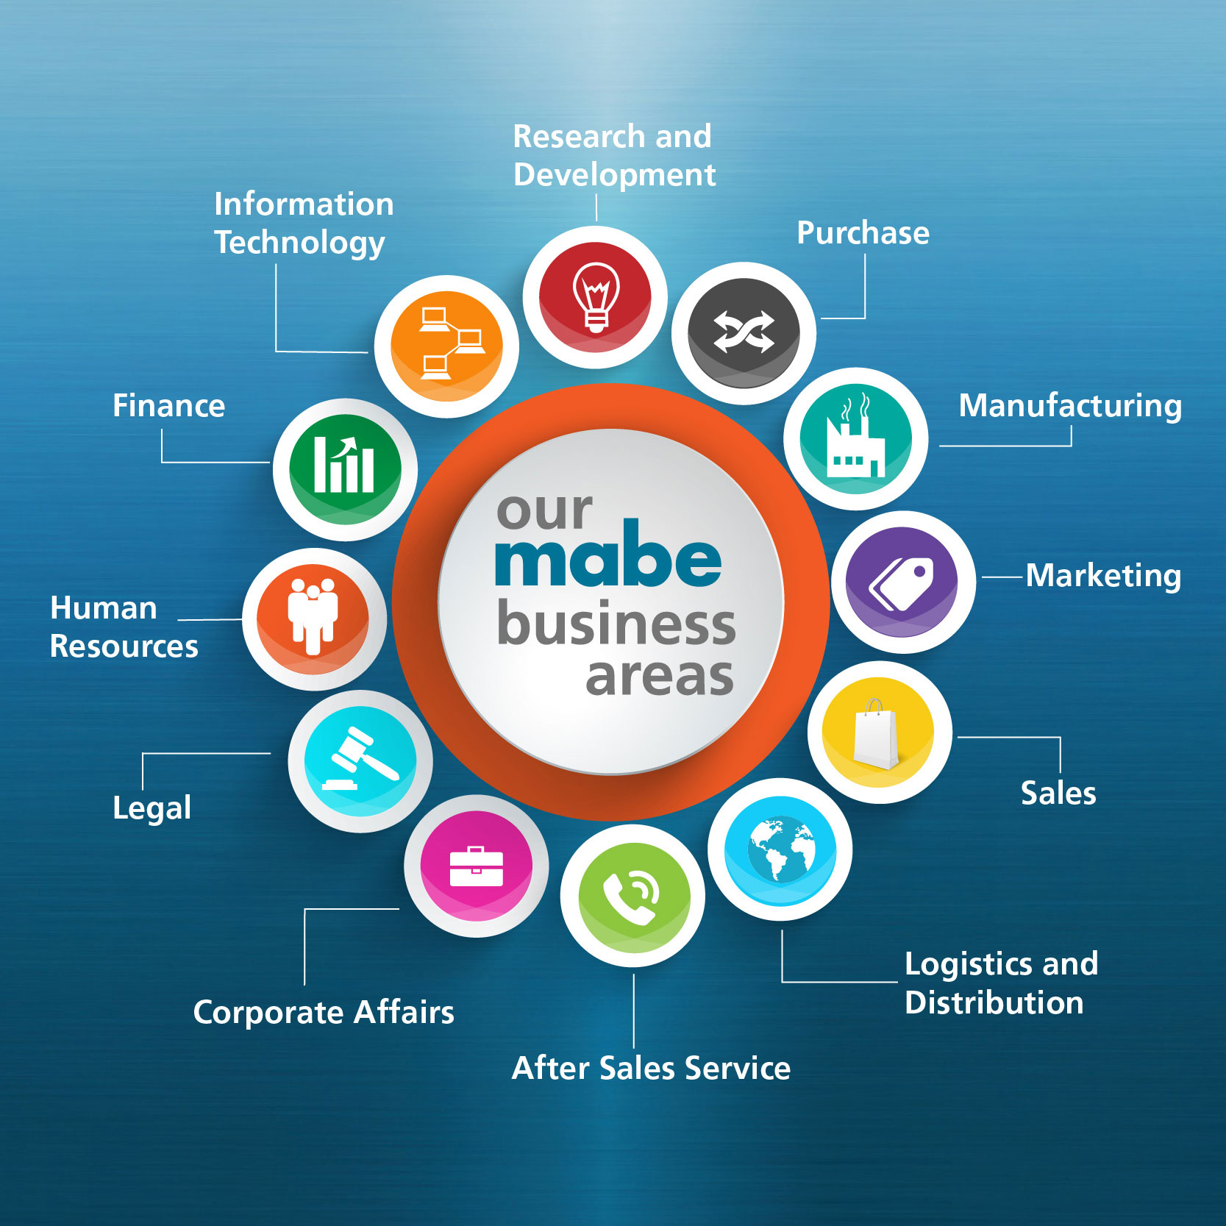
Objective
In this modern world whatever may be the field in which human beings are a part are mainly revolving around a word “business”.

Slide 7

And most of the business in this busy world will happens via online. Online shopping had made people’s life easier and faster.

Slide 8


In any area of domain every website administrators will think of how to expand their business.

Slide 9
Related work
Yanthy et al [1] in this paper author states about the important goal in data mining is to reveal hidden knowledge from data.
Rakesh Agarwal [2] proposed the Apriori algorithm. It is one of the Data Mining Algorithm which is used to find the frequent items/item set from a given data repository. The algorithm involves 2 steps
a. Pruning
b. Joining
Han [3, 4] presented a new association rule mining approach that does not use candidate rule generation called FP-growth that generates a highly condensed frequent pattern tree (fptree) representation of the transactional database.

Slide 10
Proposed methods
Apriori Algorithm
FP-growth Algorithm

Slide 11
Apriori Algorithm
It is one of the mechanism useful for generating association rules
by taking support, confidence, lift as parameters
1. Let k=1
2. Generate frequent itemsets of length 1
3. Repeat until no new frequent itemsets are identified
a. Generate length (k+1) candidate itemsets from length k frequent itemsets.
b. Prune candidate itemsets containing subsets of length k that are infrequent.
c. Count the support of each candidate by scanning the DB.
d. Eliminate candidates that are infrequent, leaving only those that are frequent.

Slide 12
Fp growth algorithm
This algorithm is an improvement to the Apriori method.
Using Apriori needs a generation of candidate itemsets.
A frequent pattern is generated without the need for candidate generation.
It represents the database in the form of a tree called a frequent pattern tree or FP tree.

Slide 13
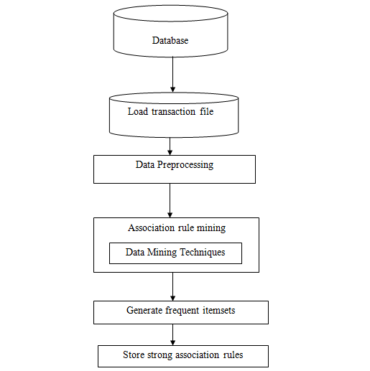
System Architecture

Slide 14
Attributes in dataset
Customer-id
Gender
Order id
Date of purchase
Items purchased like item-1,item-2…etc

Slide 15
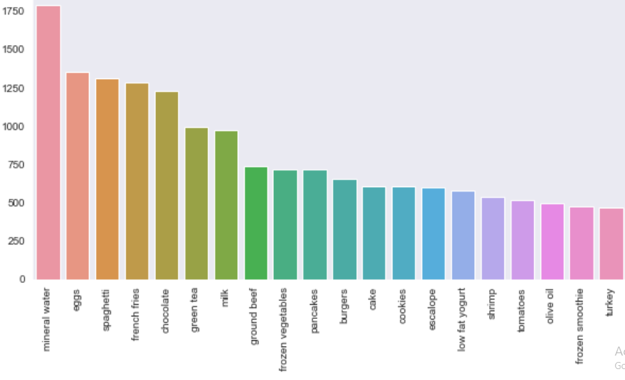
Experimental results
We can find that mineral water is the most purchased item from the store, we may advice that mineral water must be always in the stock not only that mostly we can see from the above graph what 20 items are being frequently purchased.

Slide 16
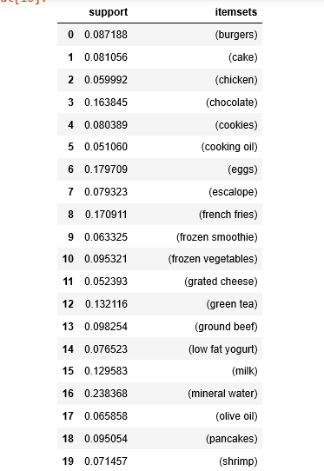
Apriori algorithm result
Whwn support count is 5% the frequent itemsets are

Slide 17
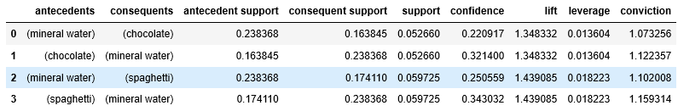
Apriori algorithm result
we got 4 rules generated with lift greater than 1.3

Slide 18
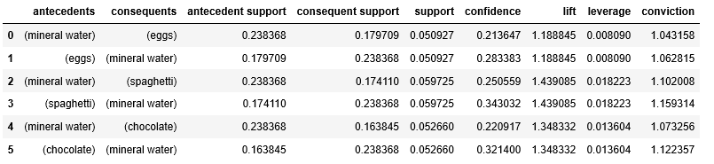
FP-Growth Algorithm Results
we got 6 rules generated with lift greater than 1.3

Slide 19
Discussions
Since FP-Growth doesn't require creating candidate sets explicitly, it can be magnitudes faster than the alternative Apriori algorithm. FP-Growth is about 5 times faster. Let's look at it.
Therefore, we can say that most of the customers buys mineral water. So, we can recommend mineral water to customers along with their products.

Slide 20
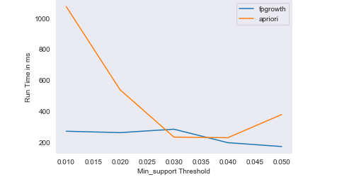
Apriori Vs FP Growth
We can gain the required insights from the above graph about the run time comparision between the apriori and fpgrowth.

Slide 21
Conclusion
When compared to apriori algorithm the Fp-growth algorithm effectively generates highly informative frequent itemsets and association rules for the data of the online user shopping details. Strong association rules are generated based on frequent items.
Thus by using the association rules generated by using Fp-Growth we can perform recommendation of items to the users/customers which will help the agents to improve their business.

Slide 22
References
file:///C:/Users/ASUS/Downloads/1813_Sanjeev_MarketBasketAnalysis.pdf
http://intelligentonlinetools.com/blog/2018/02/10/how-to-create-data-visualization-for-association-rules-in-data-mining/
https://medium.com/@deepak.r.poojari/apriori-algorithm-in-python-recommendation-engine-5ba89bd1a6da
https://en.wikipedia.org/wiki/Association_rule_learning

Slide 23


